Slide 1


CANNY EDGE DETCTION
DIP PROJECT

Slide 2
Theoretical Understanding
Noise reduction using Gaussian filter
Gradient calculation along the horizontal and vertical axis
Non-Maximum suppression of false edges
Edge tracking by hysteresis

Slide 3
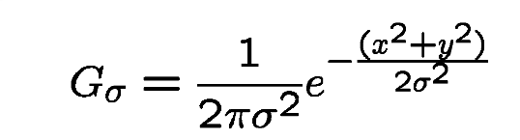
. Noise reduction using Gaussian filter
This step is of utmost importance in the Canny edge detection. It uses a Gaussian filter for the removal of noise from the image, it is because this noise can be assumed as edges due to sudden intensity change by the edge detector.

Slide 4
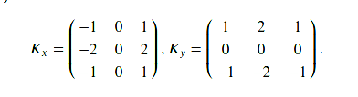
Gradient calculation
When the image is smoothed, the derivatives Ix and Iy are calculated w.r.t x and y axis. It can be implemented by using the Sobel-Feldman kernels convolution with image as given:

Slide 5
Non-Maximum Suppression
This step aims at reducing the duplicate merging pixels along the edges to make them uneven. For each pixel find two neighbors in the positive and negative gradient directions, supposing that each neighbor occupies the angle of pi /4, and 0 is the direction straight to the right. If the magnitude of the current pixel is greater than the magnitude of the neighbors, nothing changes, otherwise, the magnitude of the current pixel is set to zero.

Slide 6
Double Thresholding
The gradient magnitudes are compared with two specified threshold values, the first one is lower than the second. The gradients that are smaller than the low threshold value are suppressed, the gradients higher than the high threshold value are marked as strong ones and the corresponding pixels are included in the final edge map. All the rest gradients are marked as weak ones and pixels corresponding to these gradients are considered in the next step.

Slide 7
Edge Tracking using Hysteresis
Since a weak edge pixel caused by true edges will be connected to a strong edge pixel, pixel W with weak gradient is marked as edge and included in the final edge map if and only if it is involved in the same connected component as some pixel S with strong gradient. In other words, there should be a chain of neighbor weak pixels connecting W and S (the neighbors are 8 pixels around the considered one). We will make up and implement an algorithm that finds all the connected components of the gradient map considering each pixel only once. After that, you can decide which pixels will be included in the final edge map

Slide 8
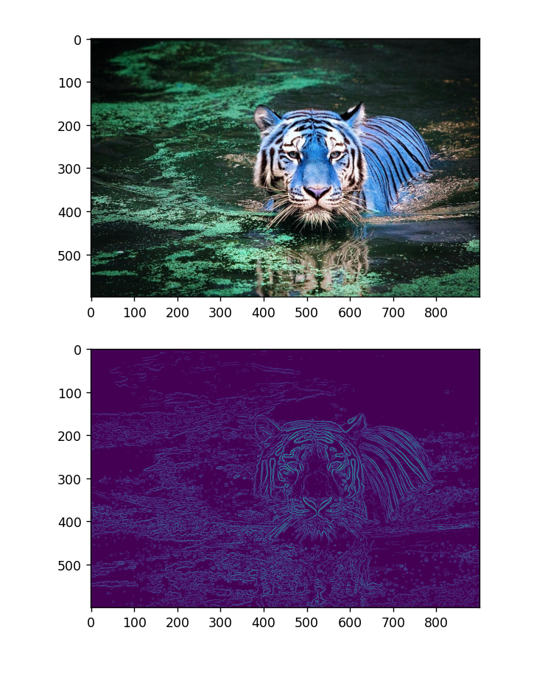
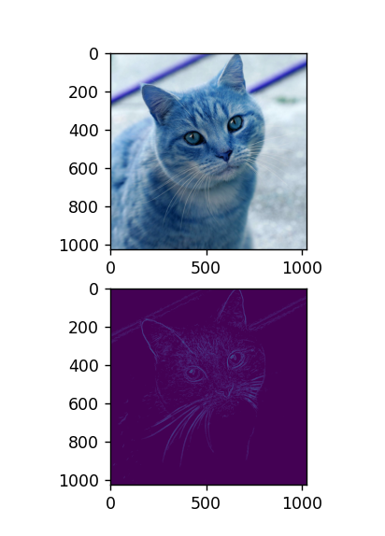
RESULT

Slide 9
APPLICATIONS
Object Detection and Recognition
Image Segmentation
Medical Imaging
Robotics and Autonomous Vehicles
Quality Inspection and Manufacturing
Gesture Recognition
Document Processing
Artificial Intelligence and Machine Learning

Slide 10
Conclusion
Canny edge detection offers a versatile and effective solution for various image analysis tasks.
Its applications span across multiple domains, making it a valuable tool in modern technology.

Slide 11
THANK YOU
MADE BY : SHUBHAM GUPTA

